Slide 1
MAJOR PROJECT I
Name: Rai Guru Raj
Email: sahil6rai@gmail.com
Batch: 24th June'21

Slide 2
POWER BI
Data Used
1. Financials
2. Marvel Superheroes
3. Premium Cars
4. World Cup

Slide 3
1. Financials

Slide 4
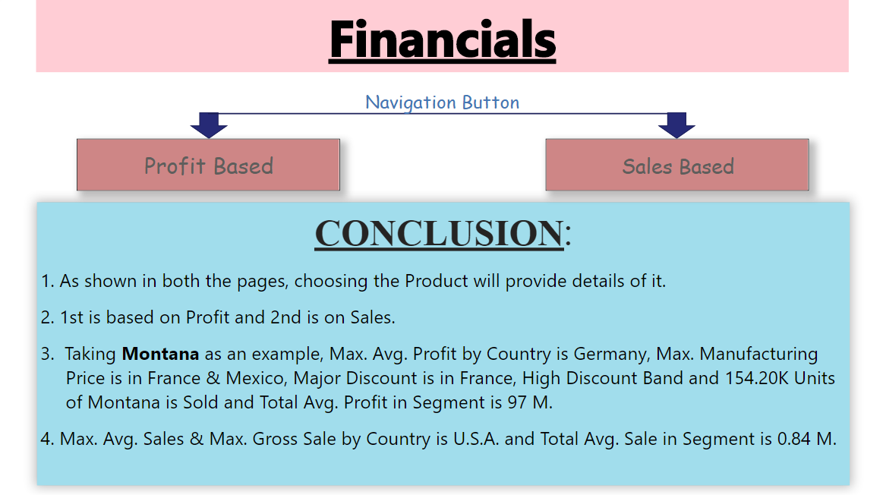
Page 1: Home (Navigation Button, Conclusion)
Profit filter on All Pages

Slide 5
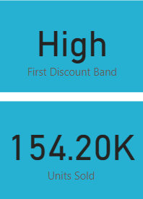
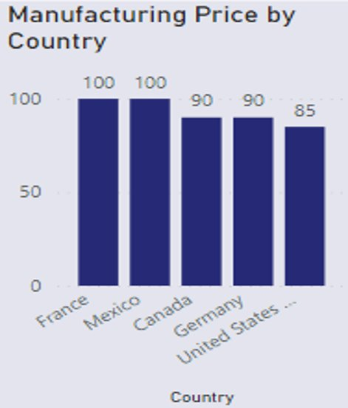
For Page 2 & 3
This Slicer shows Product Name in which Montana is selected.
This Card shows Montana's High Discount Band and 154.20K Units Sold.
This Clustered Column Chart shows Manufacturing Price by Country.
Manufacturing Price is Max. In France.

Slide 6
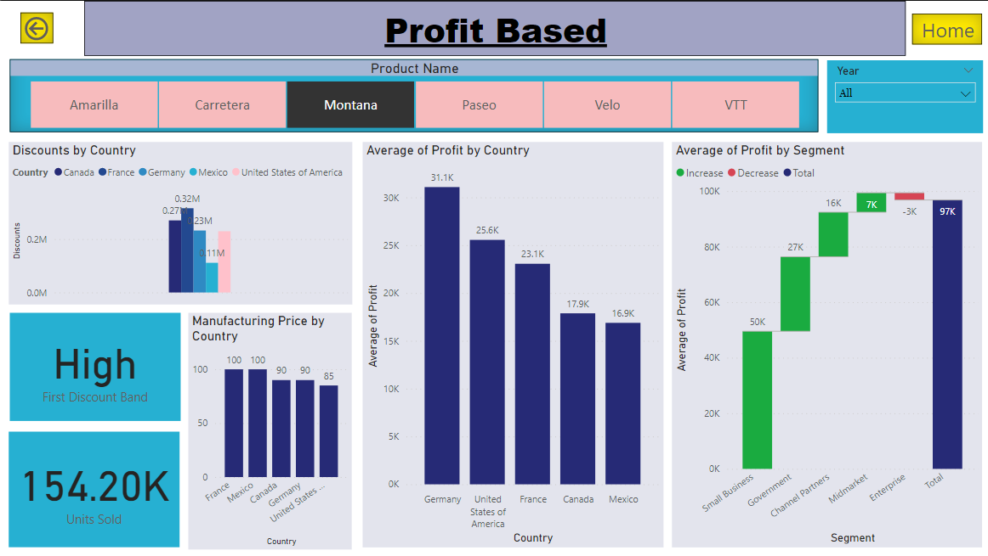
Page 2: Profit Based
Profit filter on this Page
Card-Discount Band &
Units Sold
Slicer-Year & Product Name

Slide 7
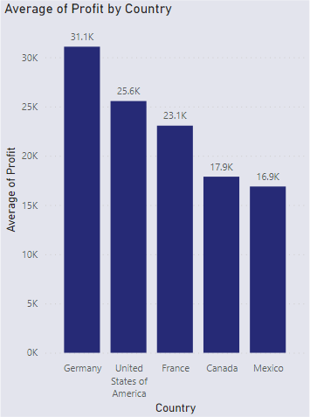
This Clustered Column Chart shows Average Profits by Country.
Germany has Max. Profit of 31.1K followed by U.S.A., France, Canada, Mexico of 25.6K, 23.1K, 17.9K, 16.9K respectively.

Slide 8
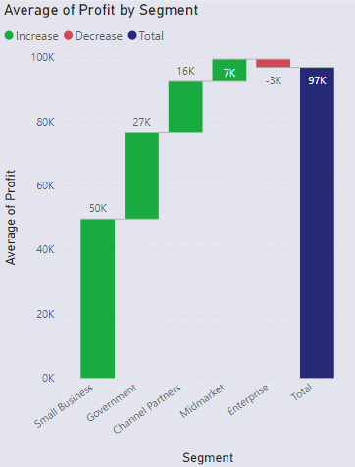
This Waterfall Chart shows Average Profits by Segment.
Profit is Max. In Small Business.
Total Profit is 97K.

Slide 9
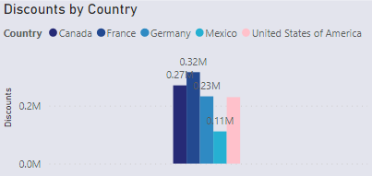
This Clustered Column Chart shows Discount by Country.
France gets Max. Discount followed by Canada, Germany, U.S.A. and Mexico

Slide 10
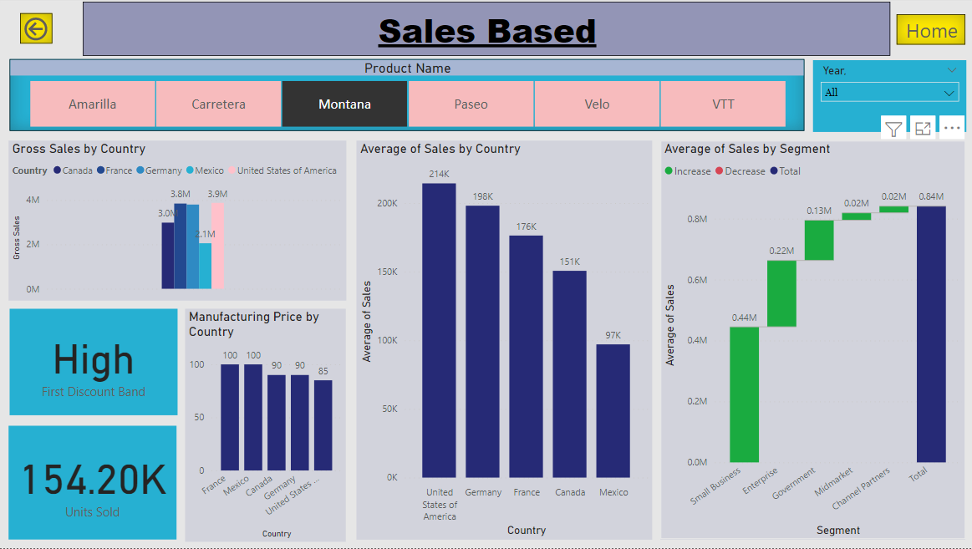
Page 3: Sales Based
Profit filter on this Page
Card-Discount Band &
Units Sold
Slicer-Year & Product Name

Slide 11
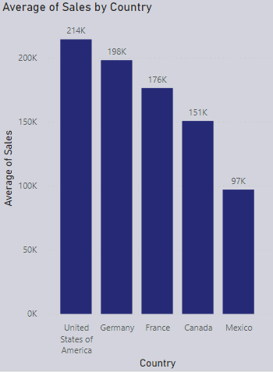
This Clustered Column Chart shows Average Sales by Country.
U.S.A. has Max. Sales of 214K followed by Germany, France, Canada and Mexico of 198K, 176K, 151K and 97K respectively.

Slide 12
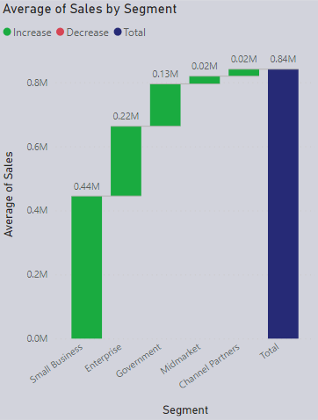
This Waterfall Chart shows Average Sales by Segment.
Small Business has Max. Sales.
Total Sale is 0.84M.

Slide 13
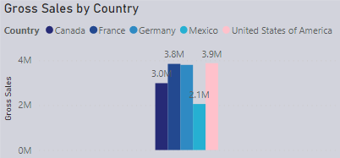
This Clustered Column Chart shows Gross Sales by Country.
U.S.A. gets Max. Gross Sales followed by France, Germany, Canada and Mexico.

Slide 14
2. Marvel Superheroes

Slide 15
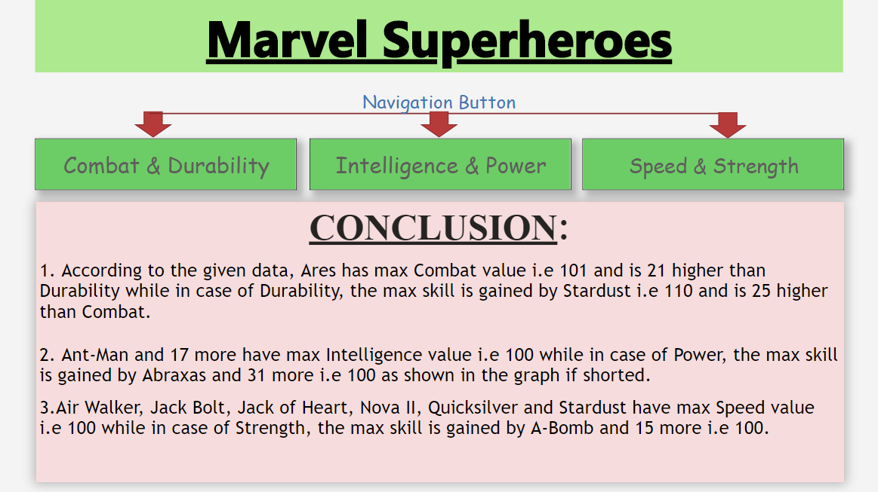
Page 1: Home (Navigation Button, Conclusion)
Alignment & Tier filter on All Pages

Slide 16
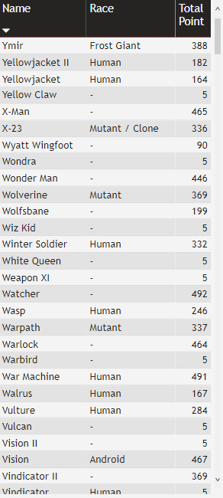
For Page 2, 3 & 4
This Table shows Name in desc. Order with Race & Total Point accordingly.

Slide 17
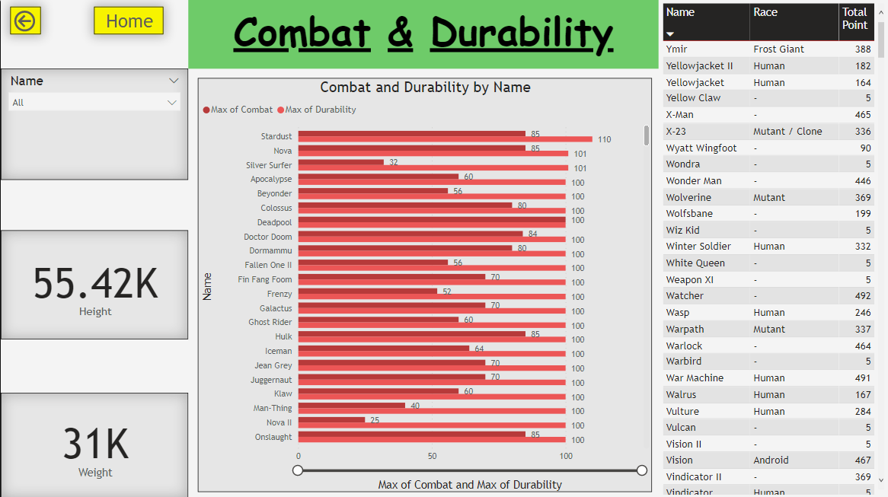
Page 2: Combat & Durability Stats
Card- Heigth & Weight
Slicer- Name

Slide 18
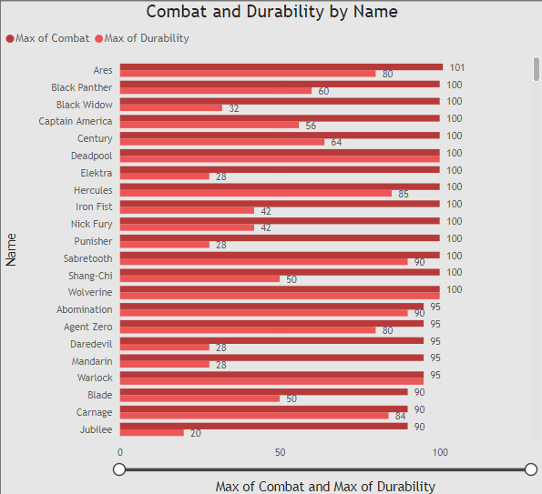
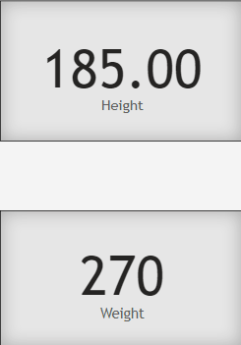
This Clustered Bar Chart shows Combat as sorted in descending order.
Ares has max Combat value i.e 101 and is 21 higher than Durability.
Whose Heigth & Weigth is 185 & 270 resp.

Slide 19
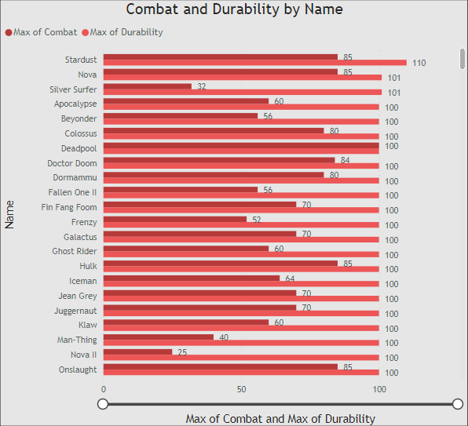
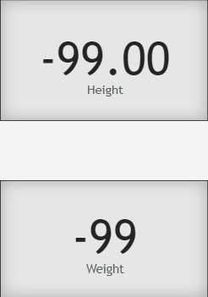
This Clustered Bar Chart shows Durability as sorted in descending order.
In case of Durability, the max skill is gained by Stardust i.e 110 and is 25 higher than Combat.
Whose both Heigth & Weigth is –99.

Slide 20
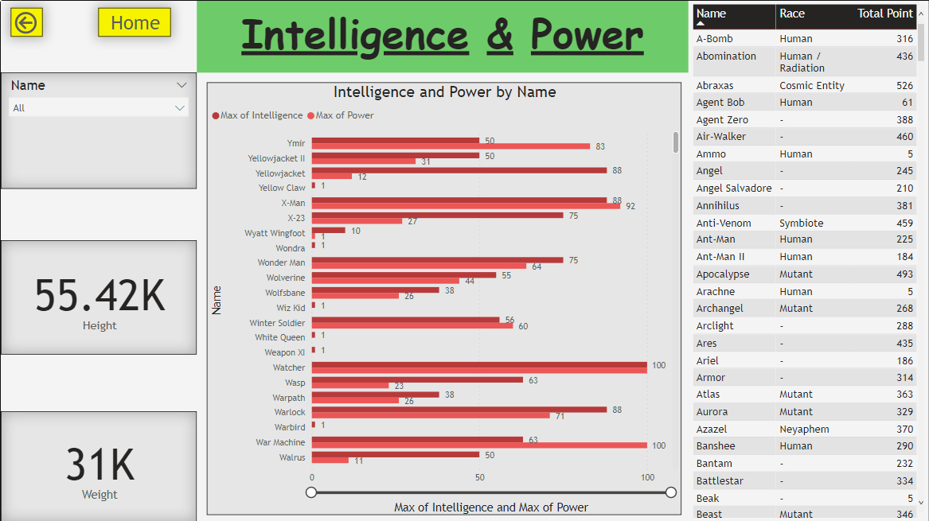
Page 3: Intelligence & Power Stats
Card- Heigth & Weight
Slicer- Name

Slide 21
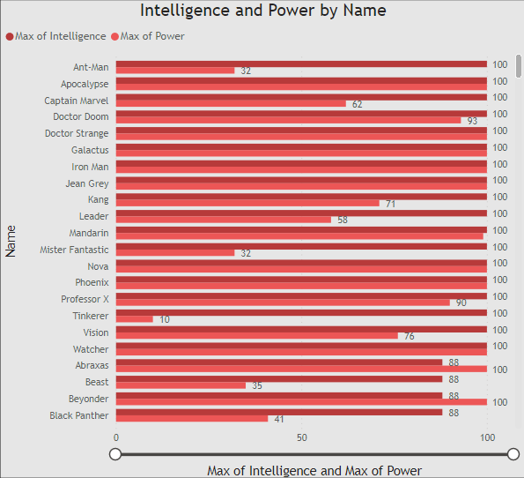
This Clustered Bar Chart shows Intelligence as sorted in descending order.
Ant-Man and 17 more have max Intelligence value i.e 100.

Slide 22
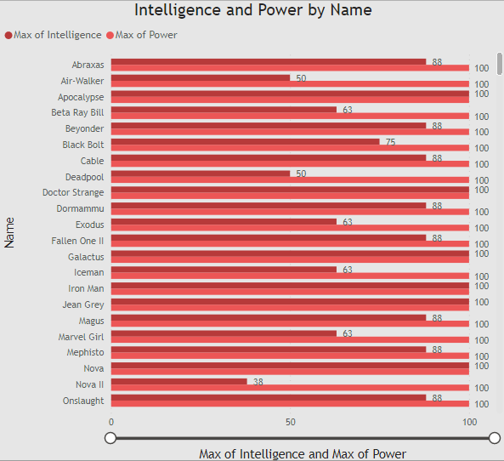
This Clustered Bar Chart shows Intelligence as sorted in descending order.
Ant-Man and 17 more have max Intelligence value i.e 100.

Slide 23
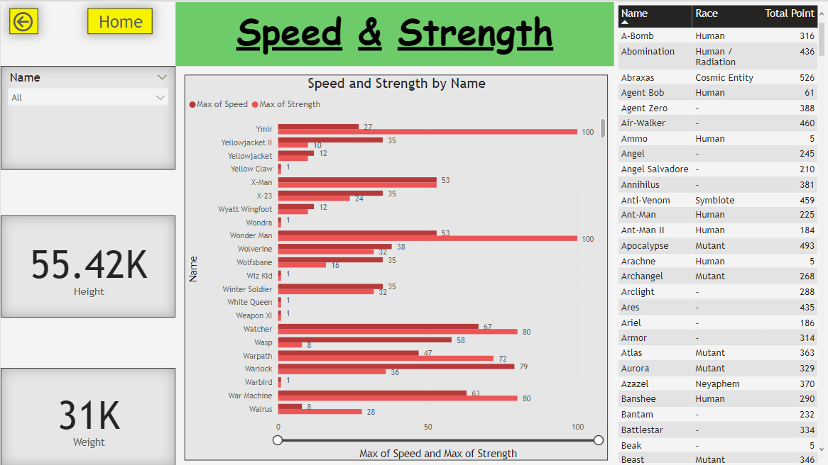
Page 3: Intelligence & Power Stats
Card- Heigth & Weight
Slicer- Name

Slide 24
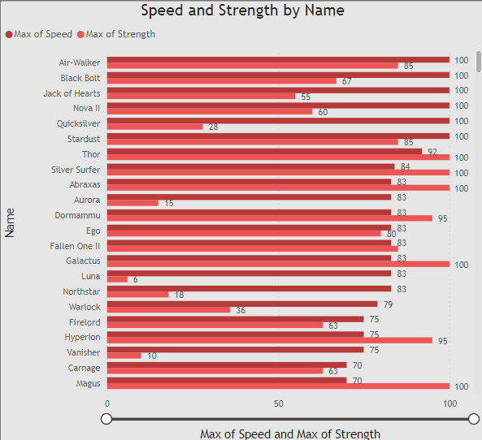
This Clustered Bar Chart shows Speed as sorted in descending order.
Air Walker, Jack Bolt, Jack of Heart, Nova II, Quicksilver and Stardust have max Speed value i.e 100.

Slide 25
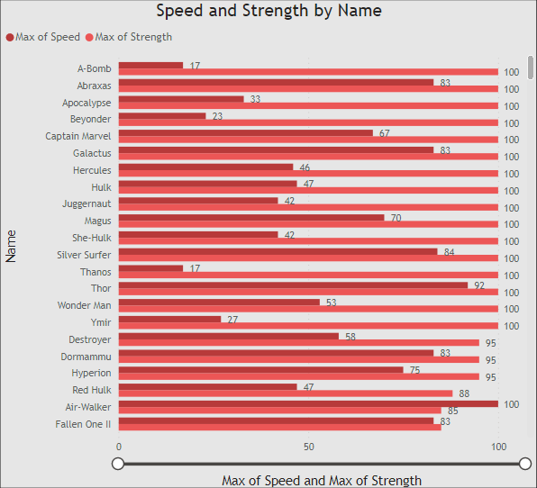
This Clustered Bar Chart shows Speed as sorted in descending order.
In case of Strength, the max skill is gained by A-Bomb and 15 more i.e 100.

Slide 26
3. Premium Cars

Slide 27
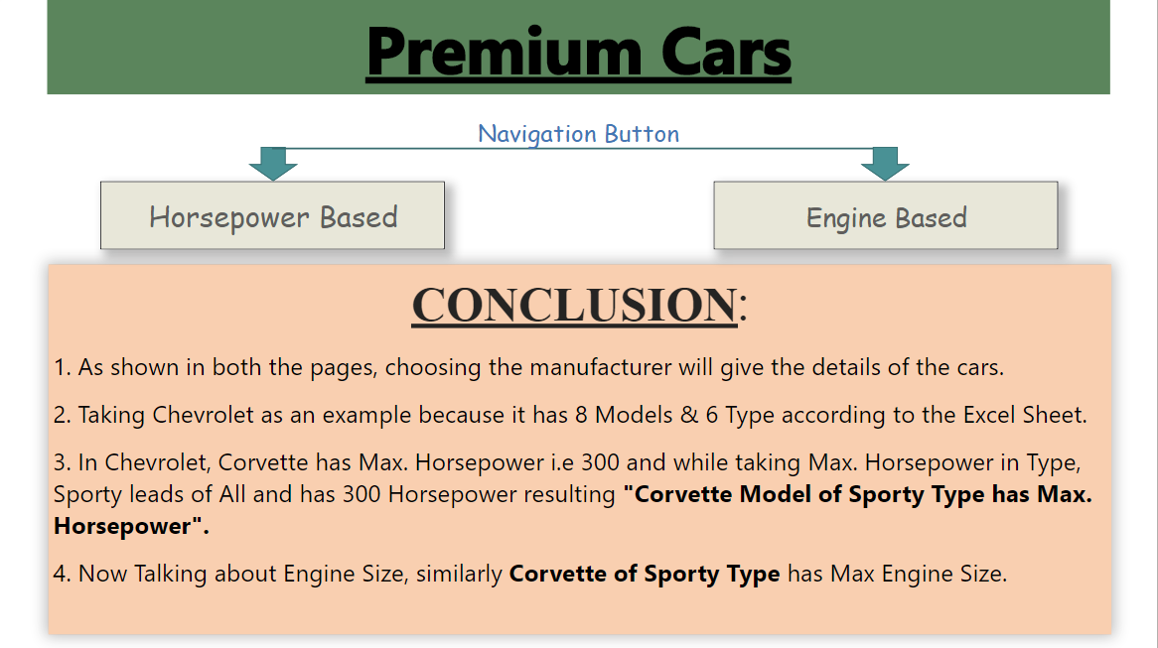
Page 1: Home (Navigation Button, Conclusion)
Alignment & Tier filter on All Pages

Slide 28
For Page 2 & 3
This Slicer shows Manufacturer Name in which Chevrolet is selected.

Slide 29
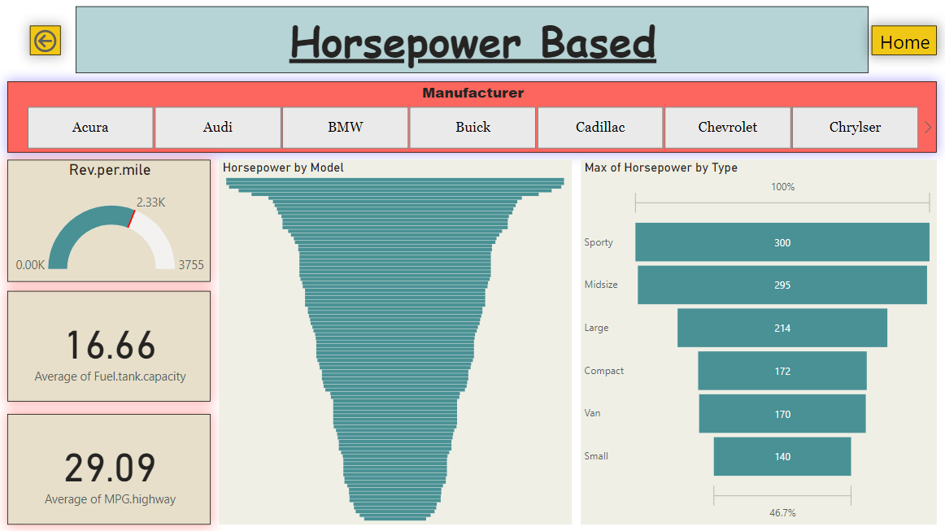
Page 2: Horsepower Based
Card- Avg. of Fuel Tank
Capacity & Avg. of
MPG Highway
Slicer- Manufacturer Name

Slide 30
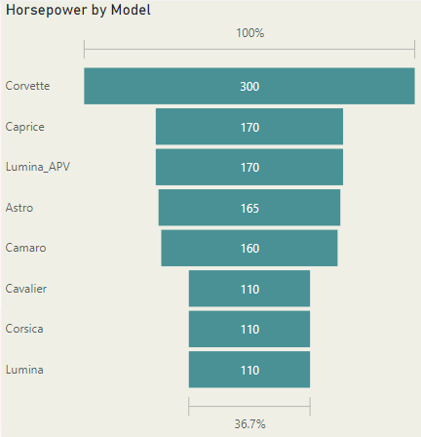
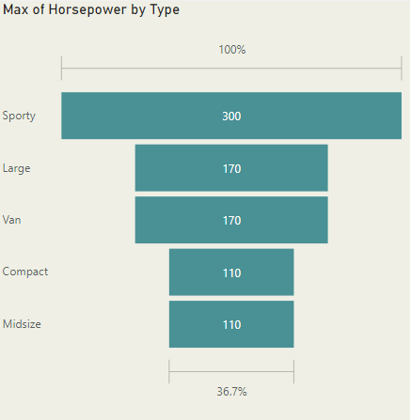
In Chevrolet, Corvette has Max. Horsepower i.e 300 and while Sporty(taking Max. Horsepower in Type) leads of All and has 300 Horsepower resulting "Corvette Model of Sporty Type has Max. Horsepower".

Slide 31
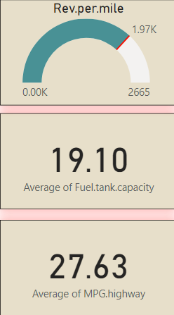
This Gauge shows 1.97K Rev.per.mile of Chevrolet.
Chevrolet's Avg. Fuel Tank Capacity is 19.10.
It's Avg. MPG Highway is 27.63.

Slide 32
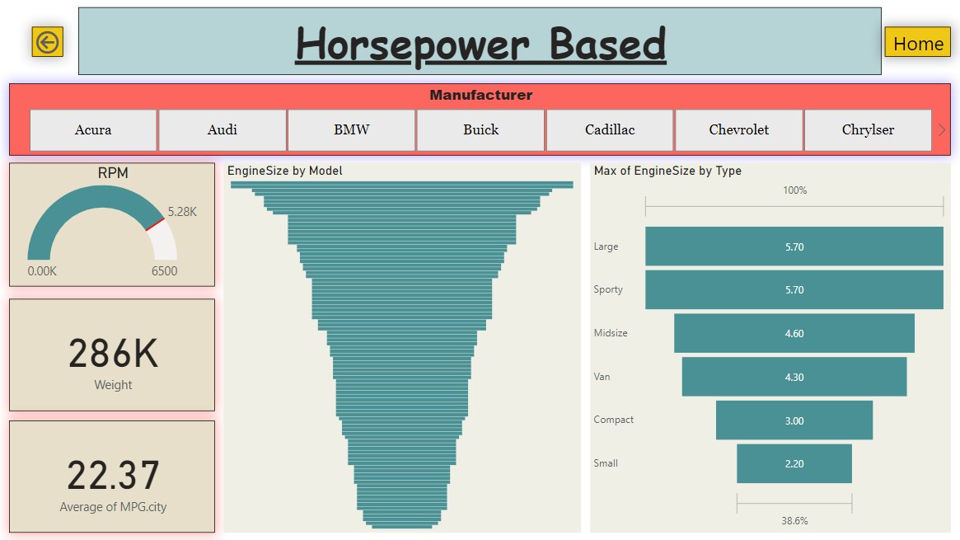
Page 2: Horsepower Based
Card- Avg. of Fuel Tank
Capacity & Avg. of
MPG Highway
Slicer- Manufacturer Name

Slide 33
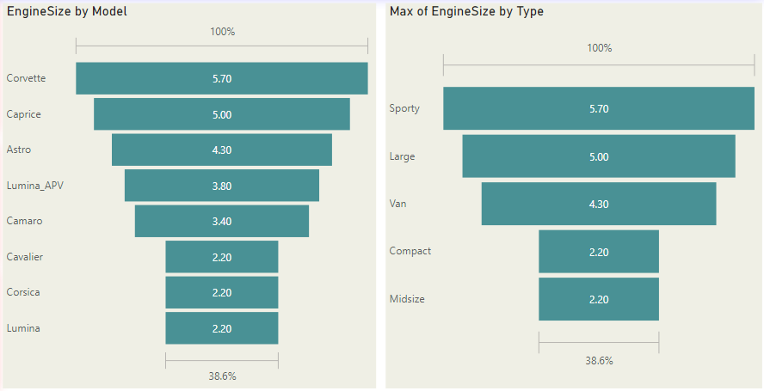
In Chevrolet, Corvette has Max. Engine Size i.e 5.7 and while Sporty(taking Max. Engine Size in Type) leads of All and has 5.7 Engine Size resulting "Corvette Model of Sporty Type has Max. Engine Size".

Slide 34
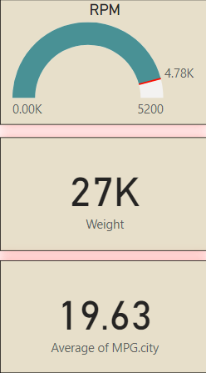
This Gauge shows 4.78K RPM of Chevrolet.
Chevrolet's Weigth is 27K
It's Avg. MPG City is 19.63.

Slide 35
4. World Cup

Slide 36
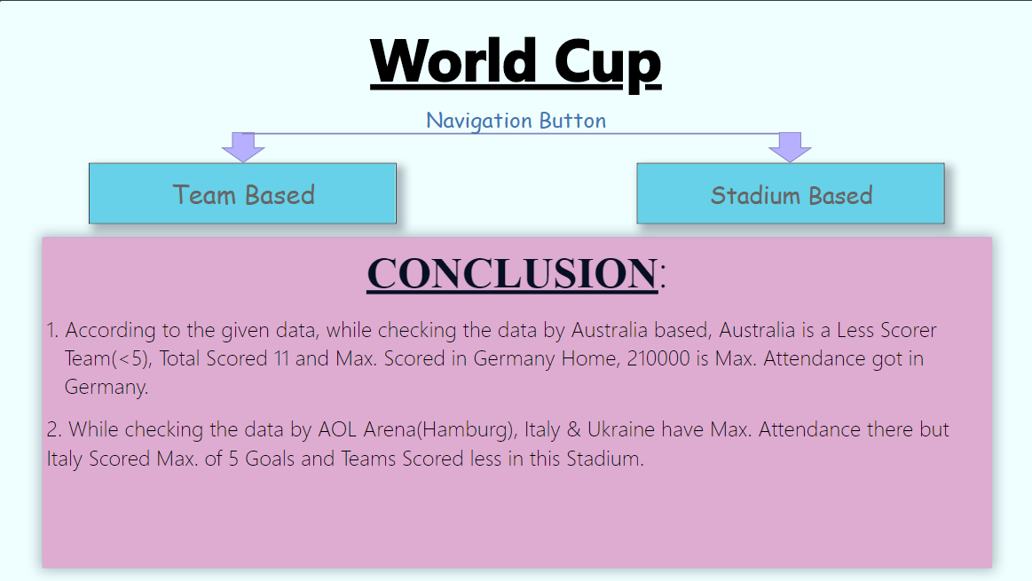
Page 1: Home (Navigation Button, Conclusion)
Scorer filter on All Pages

Slide 37
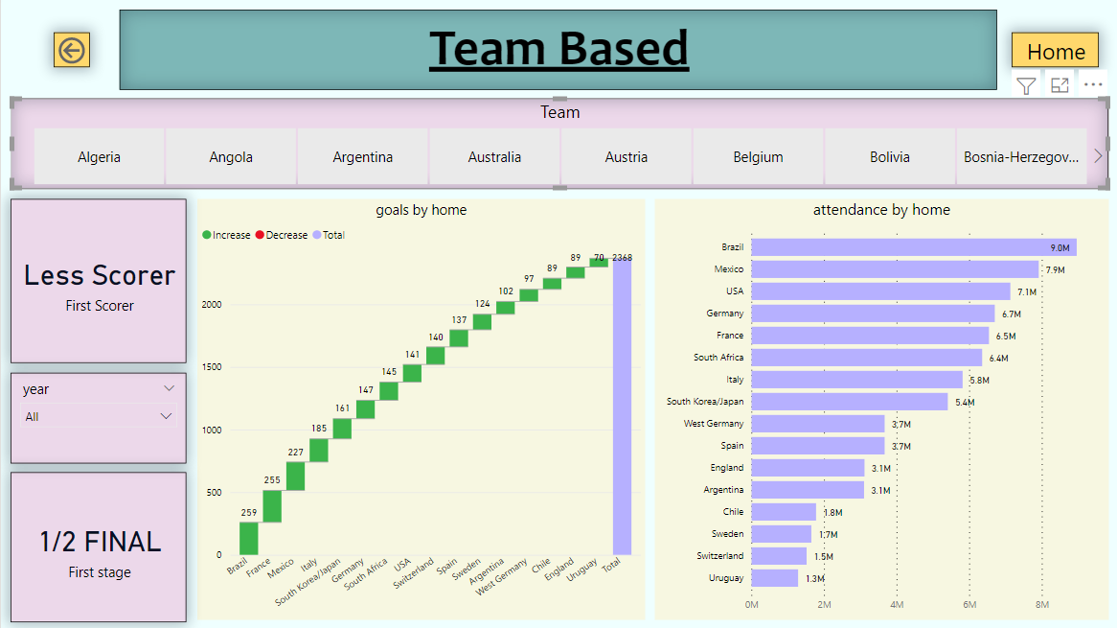
Page 2: Team Based
Card- First Scorer First
Stage.
Slicer- Team Name & Year

Slide 38
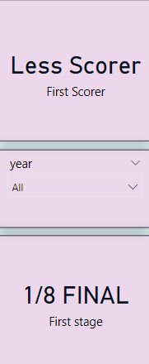
This Slicer shows Team Name in which Australia is selected.
This Card shows Australia is Less Scorer of all Teams.
This Slicer is of Year.
Australia is 1/8 Final Stage.

Slide 39
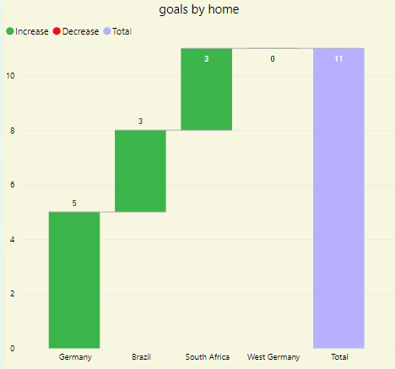
This Waterfall Chart shows Goals by Home.
Australia made Max. Goals i.e 5 in Germany followed by Brazil and South Africa with 3 Goals and then 0 by West Germany.
Total Goals by Australia is 11.

Slide 40
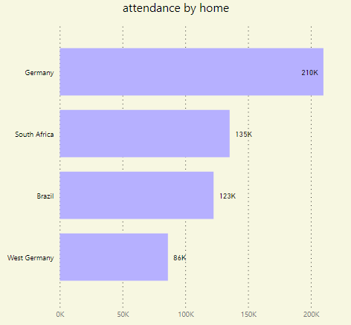
This Clustered Bar Chart shows Attendance by Home.
Australia has Max. Attendance i.e 210K in Germany followed by Brazil, South Africa and West Germany by 135K, 123K, 86K resp.

Slide 41
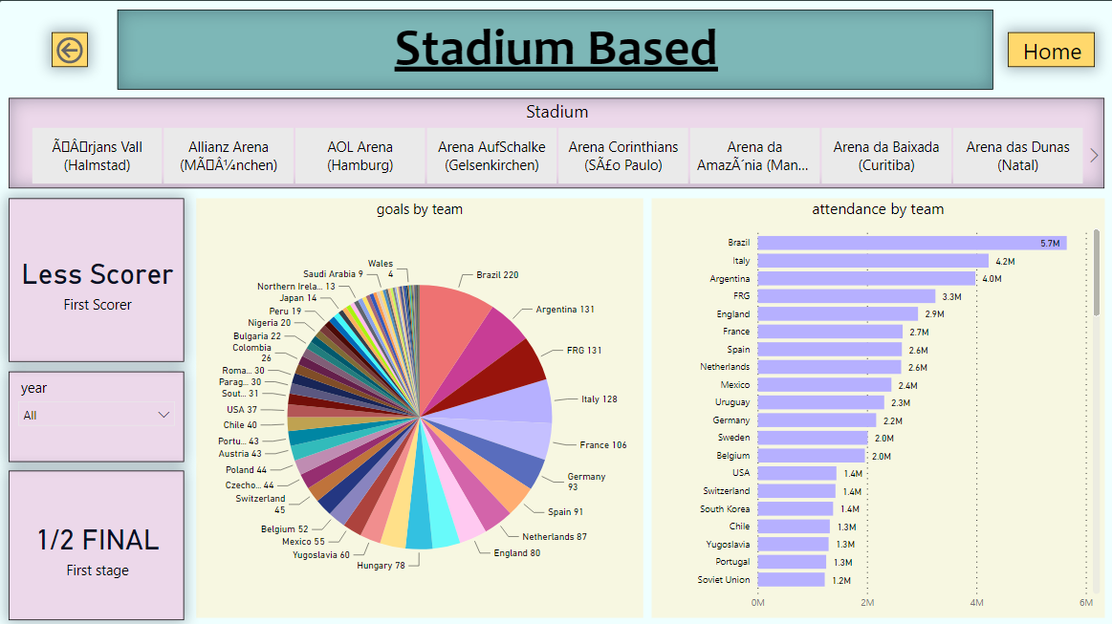
Page 3: Stadium Based
Card- First Scorer First
Stage.
Slicer- Stadium Name & Year

Slide 42
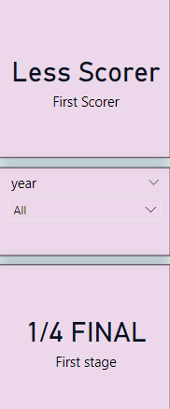
This Slicer shows Stadium Name in which AOL Arena(Hamburg) is selected.
This Card shows Team scored less in Hamburg Stadium.
This Slicer is of Year.
Team is 1/4 Final Stage on this stadium.

Slide 43
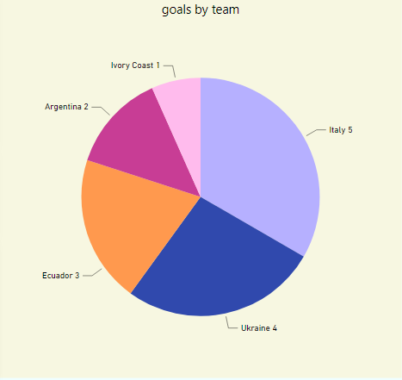
This Pie Chart shows Goals by Team.
Italy made Max. Goals i.e 5 of all Teams followed by Ukraine(4), Ecuador(3), Argentina(2) and Ivory Coast(1)

Slide 44
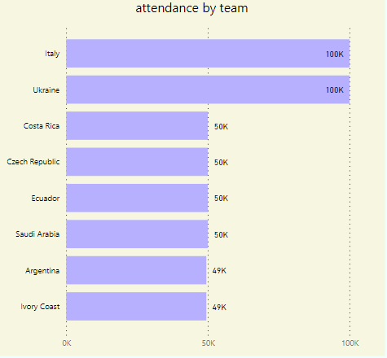
This Clustered Bar Chart shows Attendance by Team.
Italy & Ukraine has Max. Attendance i.e 100K of all in this Stadium.

